Slide 1
UE20CS971– Project Phase – 1
End Semester Assessment
Project Title : Implementation of GPT models for Text Generation in Healthcare Domain
Student’s Name : Anirban Karak
Student’s SRN : PES2202100939
Project Guide : Kaustuv Kunal

Slide 2
Agenda
Problem Statement
Abstract and Scope
Literature Survey
Suggestions from Review – 3
Design Approach
Design Constraints, Assumptions & Dependencies
Design Details
Proposed Methodology / Approach
Results
Architecture
Design Description
Technologies Used
Project Progress
References

Slide 3
Problem Statement
In healthcare domain, memorizing the usage of all the prescribed medicines along with their benefits and side effects is a challenging task. GPT-2 might be beneficial in these scenarios, as it has proven to be useful in abstractive text generation. In this paper, I explored the possibility that when medicine name is passed to GPT-2’s prompt, it will be able to summarize and generate text-based output regarding detailed description of the usage of the medicine.

Slide 4
Abstract and Scope
This paper highlights the potential of using generalized language models to extract structured texts from natural language descriptions of workflows in various industries like healthcare domain. Despite the criticality of these workflows to the business, they are often not fully automated or formally specified. Instead, employees may rely on natural language documents to describe the procedures. This paper explores the effectiveness of using generalized language models, such as GPT-2, to perform text generation directly from these texts. These models have already shown success in multiple text generation tasks, and the paper's initial results suggest that they could also be effective in text generation in healthcare domain.

Slide 5
Literature Survey
It has proven to be a very successful pattern in deep learning to pre-train models on large scale unlabeled data via careful designed self-supervision tasks and then transfer to downstream tasks by fine-tuning on them.
Downstream tasks can benefit from the learned representations from the pre-trained models.
A previous work on pre-training GPT on biomedical literature is DARE. However, they pre-train GPT on very limited amount of data (only 0.5M PubMed abstracts) and use it only for data-augmentation for relation extraction task.
While it is true that AI language models like GPT-2 still have limitations in accurately generating human-like text, it is also worth noting that they have made significant strides in recent years.

Slide 6
Suggestions from Review - 3
Since this is a generative model, hence it was suggested to measure the model performance with ROUGE and BLEU score.
Guide also suggested to generate graphs for comparing with other existing models, to visualize the language-model loss of distilGPT-2 model.
Both the above mentioned points have been successfully completed, and the results attached in upcoming slides.

Slide 7
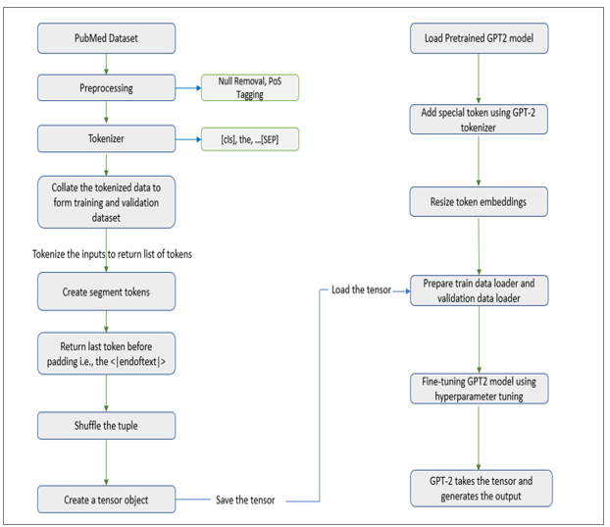
Design Approach

Slide 8
Design Constraints, Assumptions & Dependencies
Samples were collected from PubMed site https://pubmed.ncbi.nlm.nih.gov/download/ The database is maintained by NIH (National Institute of Health) also approved by FDA.
The training requires a large and diverse set of data, and the processing of this large and diverse set needs reasonable processor speed and RAM. The cloud-based solutions such as Google Collab Pro cater to the needs of developing this model, while the traditional computing may not be very flexible.
Since this research involves handling of medical data that are private and confidential, it is necessary to handle the data with utmost care to prevent unethical use.
One constraint of GPT-2 is that the token limit is 1024. We cannot pass large sentence.

Slide 9
Design Details
Novelty - I used POS tagging and BERT tokenizer for tokenization purpose
Performance - Model performance was measured using ROUGE score and BLEU score.
ROUGE-1 score was between 0.1 to 0.5 and the median value was 0.4.
ROUGE-2 score was between 0.2 to 1 and the median value was 0.6.
ROUGE-3 score was between 0.3 to 1 and the median value was 0.8
Reliability - It performs as expected with PubMed medicine dataset. I took random
medicine name and model able to generate correct text
Maintainability - This model is easy to maintain. After training I saved the model check point and
config file.
Portability - Model is very much portable. It can run on Windows, Linux and MacOS.

Slide 10
Design Details (Continued)
Legacy to Modernization – Existing medical text generation models were built on BioBERT and
ClinicalBERT but in this project GPT2 has been used.
Reusability – This model can be re-used. The final model is saved in disk in .bin file
format and anyone can load the model and use it.
Application Compatibility- This model is compatible with DistilGPT2 , Python 3.8 , pytorch 1.13
and its higher versions.

Slide 11
Proposed Methodology / Approach
1.Data Collection: PubMed medicine dataset is used to train the data.
2. Tokenization: BERT tokenizer is used for tokenization.
3. Fine tuning the token classifier: In this step I fine-tuned the token for token classification.
4. Pre-processing the raw text for GPT-2 : POS tagging was applied to the dataset. Special token was also added to the segments.
5. Training GPT2 model for text generation : In this step the model was trained on the dataset with Adam optimizer.

Slide 12
Proposed Methodology / Approach (Continued)
Is there a need for changing the approach?
We can alter the approach slightly and train the model on a variety of medical data.
Benefits of new Approach:
As model will be trained on various medical data , it will generate more diverse medical text.
Drawbacks of new Approach:
Due to increase in the volume of dataset, model will take more time on training and more
resources like RAM, GPU etc.

Slide 13
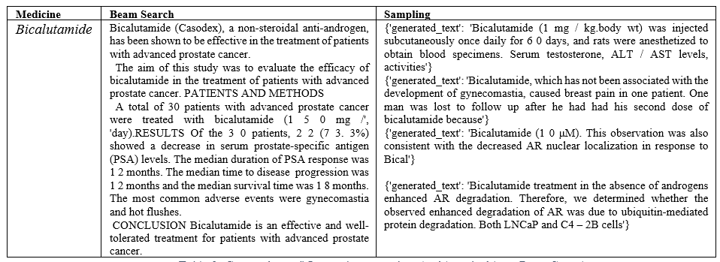
Results

Slide 14
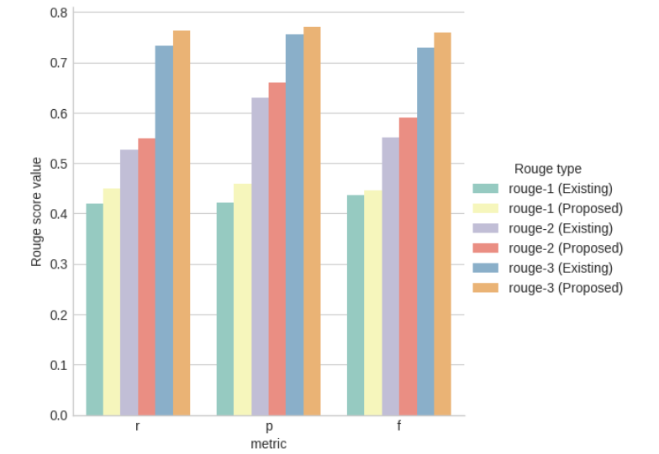
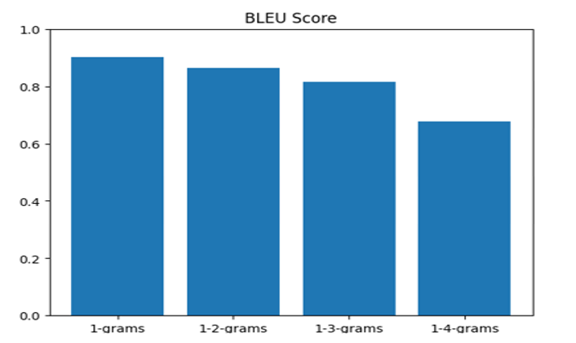
Results (Continued)

Slide 15
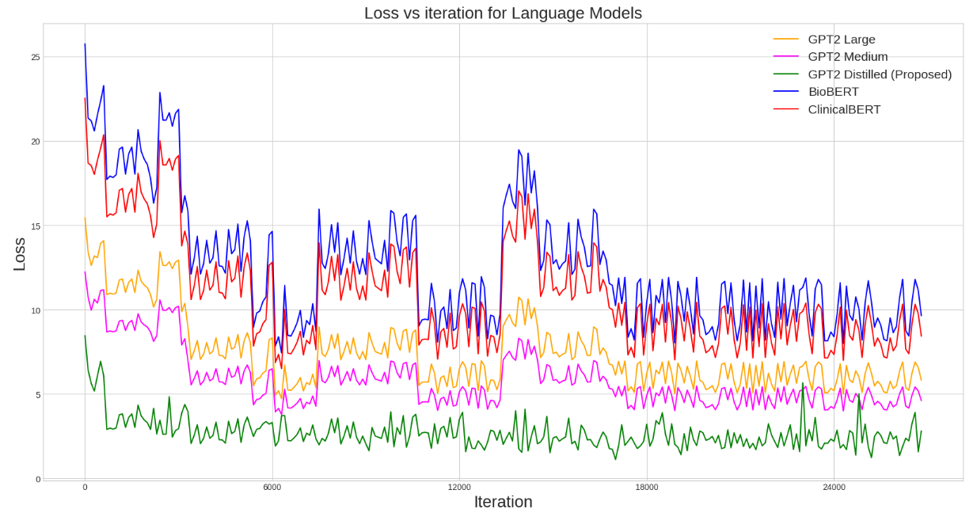
Model Comparison

Slide 16
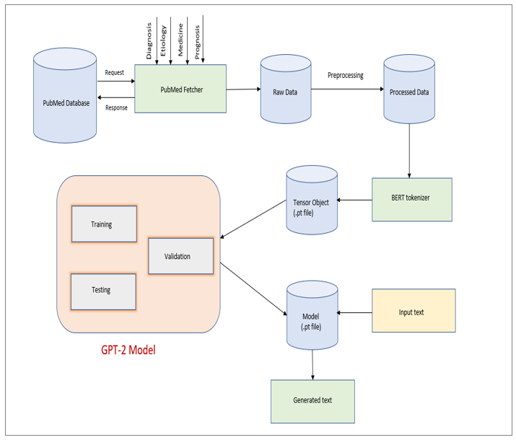
Architecture Diagram:

Slide 17
Design Description (Algorithm)
Collect the PubMed (medicine) data.
Process the raw data (null removal, special character removal, emoji removal etc).
Tokenize the process data.
Create training and validation dataset from tokenized data.
Create the segment tokens.
Return the last token before the padding.
For better result shuffle the tuple.
Create the tensor object for GPT-2 model.
Load the pretrained Distill GPT-2 model.
Add the special token using GPT-2 tokenizer.
Resize the tokens embedding as GPT-2 supports max length of 1024.
Load the previously saved tensor data using data loader and passing to the GPT2 model for training.
Fine tune the GPT-2 model using hyperparameter tuning.
GPT-2 takes the input text such as medicine name and generate the text.

Slide 18
Technologies Used
Cloud environment | Google Colab Pro Plus
Development language | Python 3.8
Deep Learning Framework | Pytorch,Tensorflow
Third party Libraries | Pandas Numpy NLTK Metaplotlib Seaborn tqdm metapub transformer
Log monitoring Framework | Tensor Board

Slide 19
Project Progress
I have successfully implemented the base paper and the model performance was as expected.
For Phase-2 I plan to extend the model to different datasets like Covid-19 dataset to measure the performance of the model in various domains of healthcare.

Slide 20
References
Luo, Renqian, Sun, Liai , Xia, Yingce , Qin, Tao Zhang, Sheng , Poon, Hoifung, Liu and Tie-Yan. BioGPT: generative pre-trained transformer for biomedical text generation and mining. Briefings in Bioinformatics, Oxford Academic, 2022.
Virapat Kieuvongngam, Bowen Tan, and Yiming Niu. Automatic text summarization of covid-19 medical research articles using bert and gpt-2.arXiv preprint arXiv:2006.01997, 2020.
Su, Nigel, Yixuan and Collier. Contrastive search is what you need for neural text generation. arXiv preprint arXiv:2210.14140, 2022
Chang, Ernie and Shen, Xiaoyu and Zhu, Dawei and Demberg, Vera and Su, Hui. Neural data-to-text generation with lm-based text augmentation. arXiv preprint arXiv:2102.03556, 2021

Slide 21
Thank You !!

